Slide 1
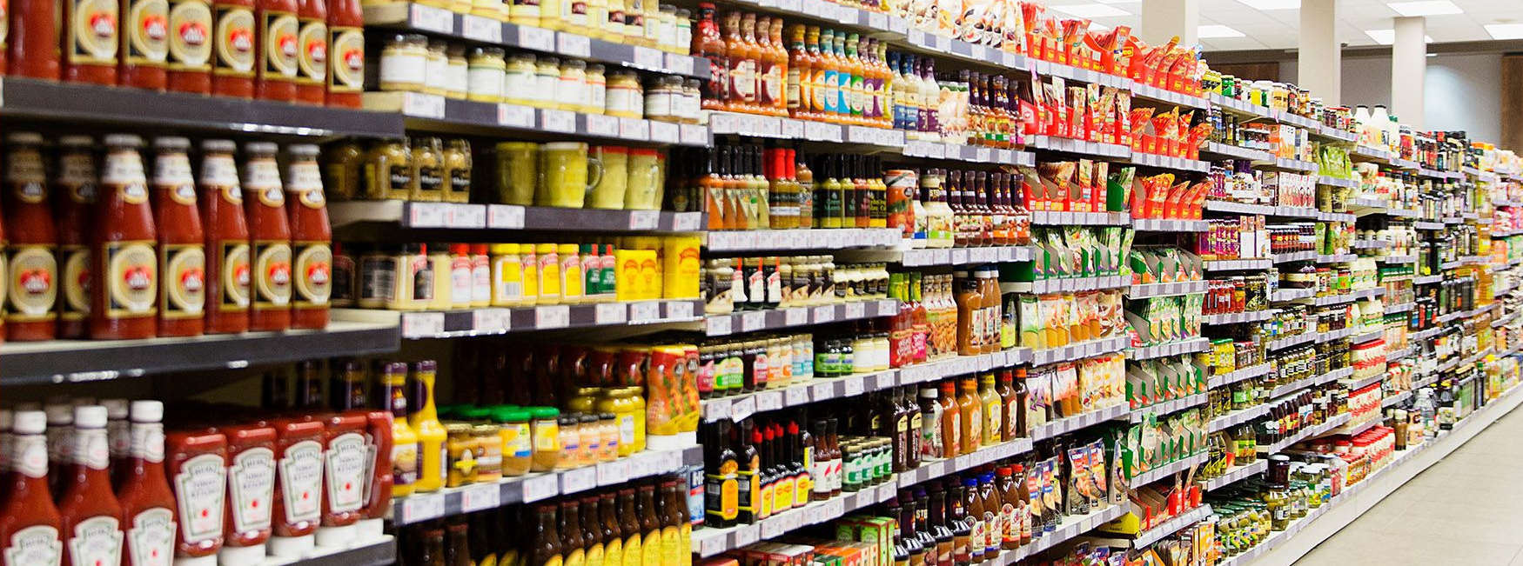
Food deserts’ impact on covid-19 metrics in Chicago
By Manli Patel, Jen Krizman, and Roxanne Meyer

Slide 2
Does grocery store availability impact covid-19 outcomes in Chicago?
While there are many compounding factors as to why specific zip codes had higher Covid-19 infection rates, we wanted to analyze if the amount of grocery stores was correlated to these outcome. We hypothesized that grocery stores, in part, have a positive impact on a zip codes’ health, which has showed to impact a populations’ COVID-19 outcome. Additionally, grocery stores have the ability to administer COVID-19 vaccinations, boosters and tests, which could positively affect a zip codes’ COVID-19 infection rates.

Slide 3
DATA Sources
US Census for Chicago (API)
City of Chicago Data Portal
Grocery Store Status
COVID-19 Hospitalizations and Deaths

Slide 4
Hypothesis 1
Within Chicago Zip Codes, zip codes with higher than average household income will have more grocery stores than zip codes with lower than average household income
Rationale: Businesses are more likely to build in areas where individuals have more disposable income to spend on their products and services

Slide 5
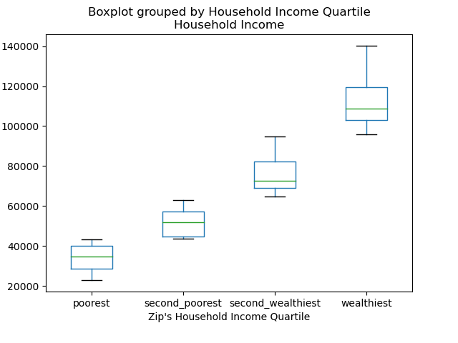
Hypothesis 1 Data
$140,125
$95,676
$95,676
Box Plot
Used bins to put the zip codes in one of 4 bins based on that zip code’s average household income
$63,889
$63,889
$43,440
$43,440
$23,019
Notes:
The purpose of those box plot was to show how skewed Chicago zip codes are in average household income. I have labeled the box plots, but this gives a nice representation of how for the first 2 quartiles of Chicago zips by average household income, they have very similar spreads from their mins to maxes of about $20K, but the upper middle class (or second wealthiest group) has a wider spread of 31.8K, and the wealthiest zips have a very wide spread at 44.4K.
Given this insight, I would anticipate that the right side of the scatterplot of annual household income vs grocery stores per capita will be quite spread out compared to the lower income zips. There also may be more variance in the higher income zips.

Slide 6
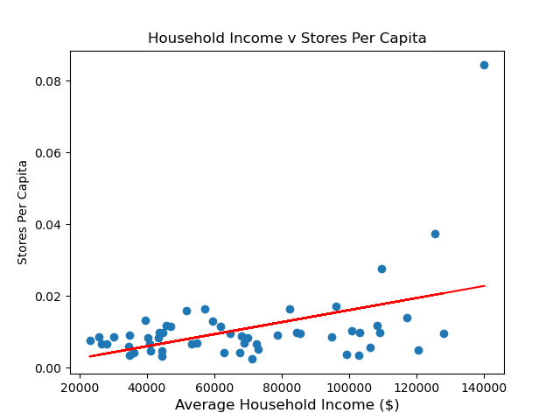
Hypothesis 1 Data(cont.)
Scatter Plot with Regression
The Regression line is modeled by the equation y = 1.679e-07x + -0.0007651913
The r-value is: 0.44475023404704944
The p-value is: 0.0007531819043198361
Notes:
I then created said scatter plot and we can see that those predictions were correct. Note how the points for average household income less than $90K are very tightly grouped close to the regression line. But once you get to the wealthiest zip quartile of $95K and greater, the variance is greater and the data points are much more spread out.
Overall, we found the r –value to be .445 which means there is a moderate, positive relationship between a zip code’s average household income and the number of stores per capita. There seems to be at least one outlier (at the highest zip), but there could be simple explanations for that, such as having a few grocery stores that are right on the boarder of their zip code and the next zip code.
Additionally, because the p-value is less than .05, these findings are significant.
We also noted that this data may be even better modeled by an exponential curve, but we have yet to learn that coding to test.

Slide 7
Hypothesis 2
Within Chicago Zip Codes, lower income areas will have higher rates of COVID-19 than higher income areas
Rationale: Lower Income areas have several contributing factors leading to these higher rates:
Less access to healthcare
Lowered ability to afford healthcare which may mitigate COVID-19 transmission

Slide 8
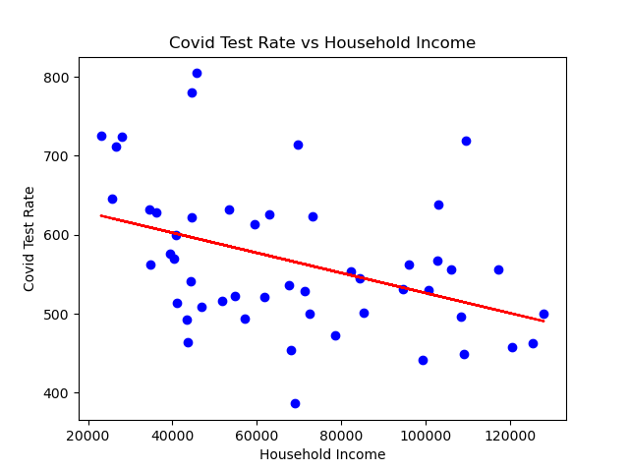
Hypothesis 2 Data
R value: -0.4099
Regression line eq: y=-0.0012707x+653.44

Slide 9
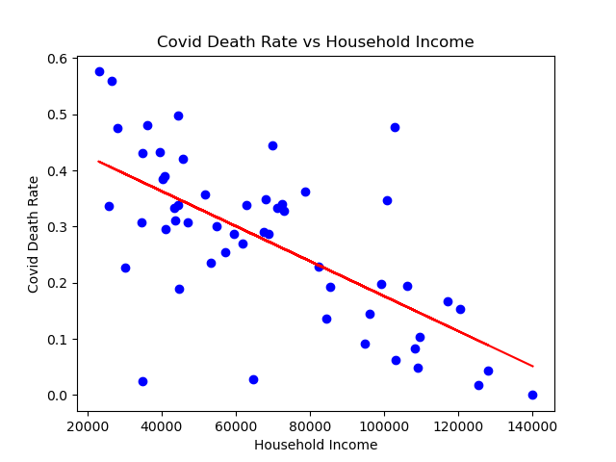
Hypothesis 2 Data(cont.)
R-value: -0.66243
Regression Line equation: y=-3.1e^-6x+0.49

Slide 10
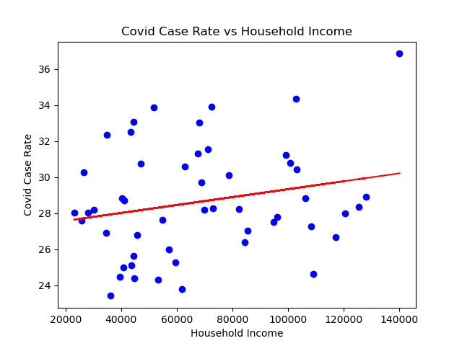
Hypothesis 2 Data(cont.)
R-value: 0.22351
Regression Line equation: y=2.19e^-5x+27.14

Slide 11
Hypothesis 3
Within Chicago Zip Codes, another variable which may have affected covid transmission, testing and deaths is education level
Rationale: Those zip codes with lower education levels may not understand the science and therefore have higher levels of distrust of the science. We would expect to see lower testing levels, higher rates of transmission, and therefore higher death rates than zip codes with higher education rates.

Slide 12
Hypothesis 3 Data

Slide 13
Hypothesis 3 Data(cont.)

Slide 14
Conclusions
Hypothesis 1: zips w/ higher average household income will have more grocery stores per capita than zip codes with lower average household income
Hypothesis 2:
Hypothesis 3:

Slide 15
Implications of the analysis

